Slide 1
L6 Group 6: IceBreaker
Samuel Cook
Anthony Brame
Robert Yearling
William Terry

Slide 2
Logline
Explore a ship as Birch Unravelling a dark secret held deep in the belly of the IceBreaker.

Slide 3
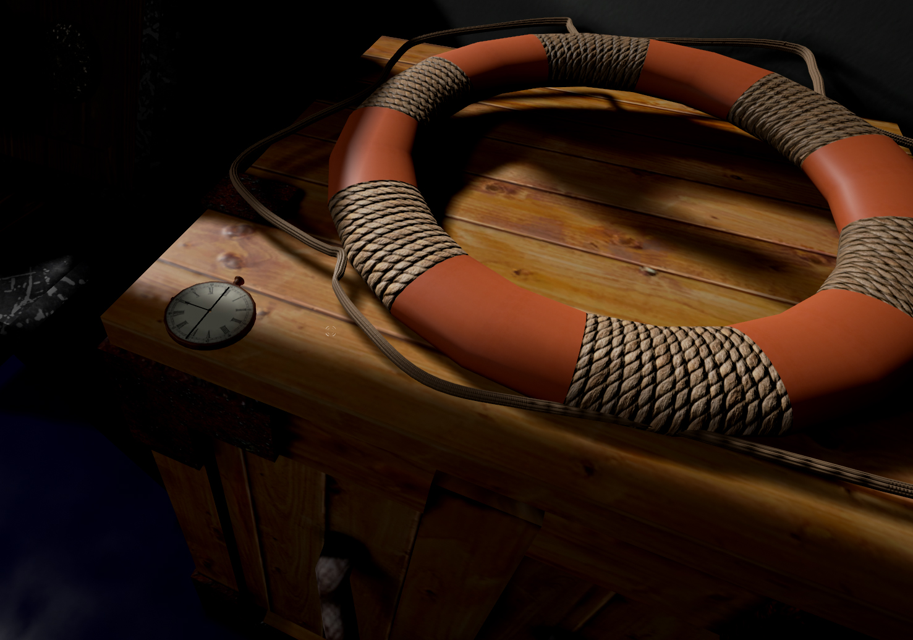

Slide 4
Demographic
Gender: Males
Age: 18 – 24 (Schell J, 2008)
Type of player: Explorer (Bartle R, 1996)

Slide 5
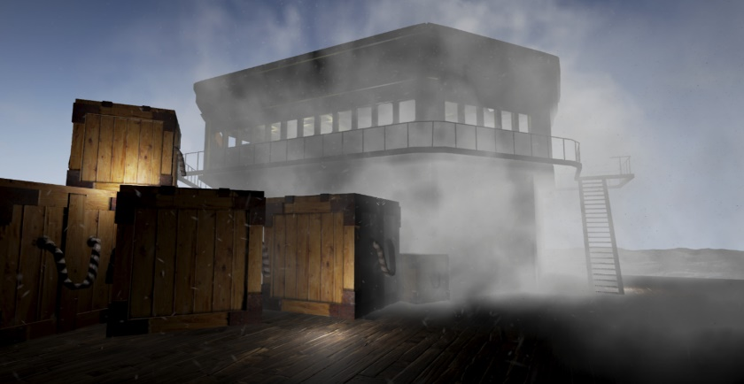
Concept
Theme: Fantasy horror Steam era 1920's
Story: Icebreaker Heading home from an arctic expedition to bring word of the discovery of an artifact, however will they make it home and if they do what will they unleash upon the world.
Entertainment though Atmosphere (Horror)
Entertainment though Thrills (Suspense)
(Phillips and Huntley, 2004)

Slide 6
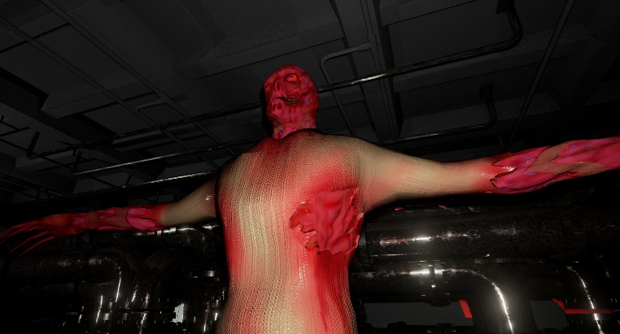
Unique Selling Points
Minimal use of non diegetic elements
Voice used to convey objectives (intercom)
Pocket watch system for player navigation and audio recording for in-game lore.

Slide 7
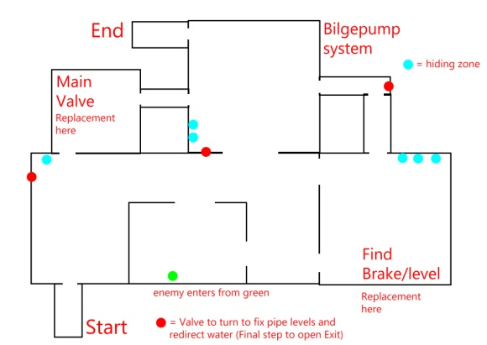
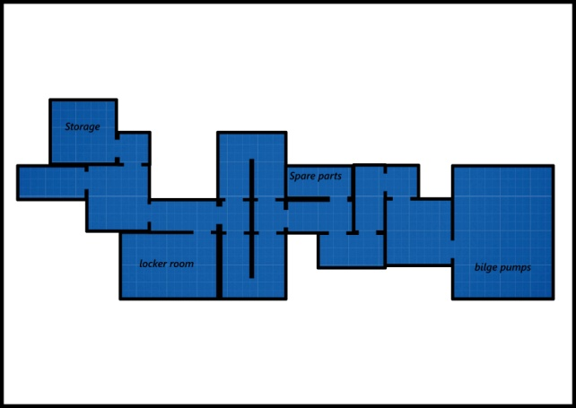
Level Design / Spatial Awareness and Logic Puzzle
Using spatial awareness, logic, timing and mechanic
Puzzles are broken up into bullet points of tasks, and then made around the level to be as diegetic to the game as possible (example bilge pump in bilge pump room, extra components in spare parts or storage, water dripping out of the pipes to indicate a valve has not been turned)
Puzzles are made with the environment and enemies in mind

Slide 8
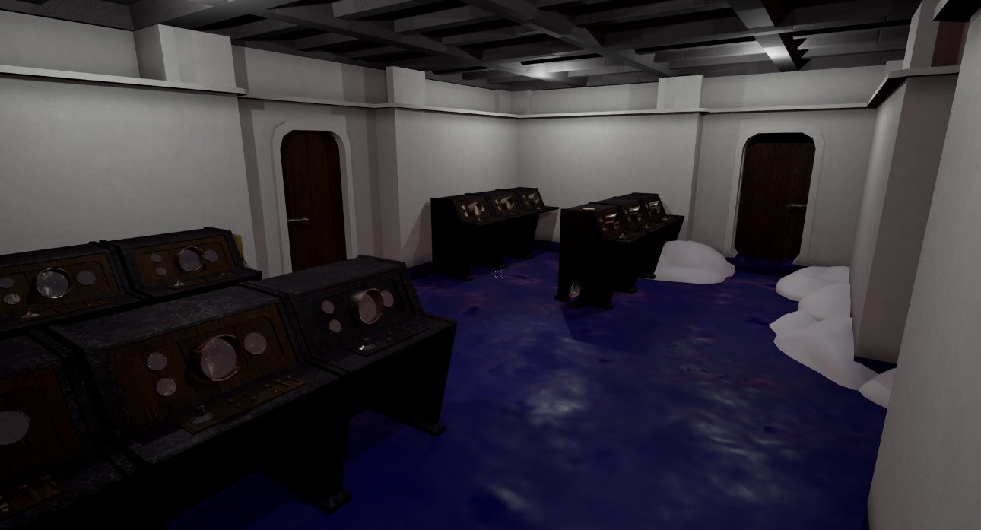
Progress
Focus:
Puzzle implementation.
Player feedback implemented in the level.
Play testing.
Implementation of play test feedback

Slide 9
Blueprints
Blilge pump puzzle
Added locations for the parts to be placed in bilge pump blueprint
Added interaction with physics objects on mouse click

Slide 10
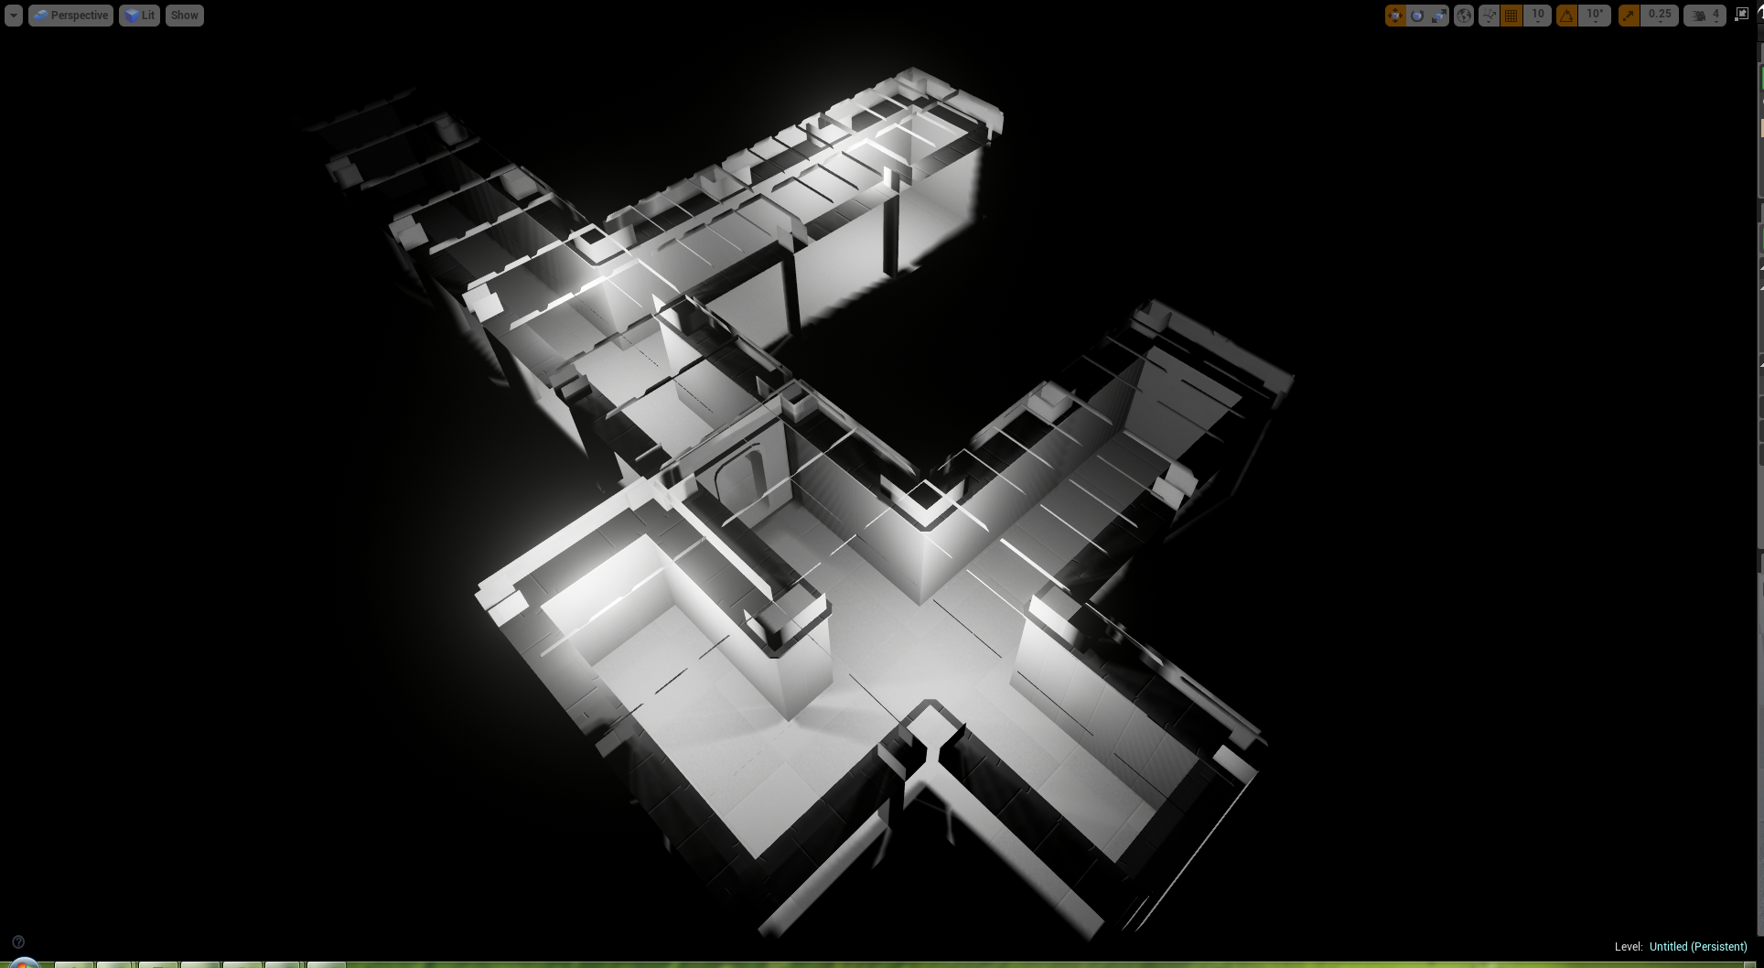

Slide 11
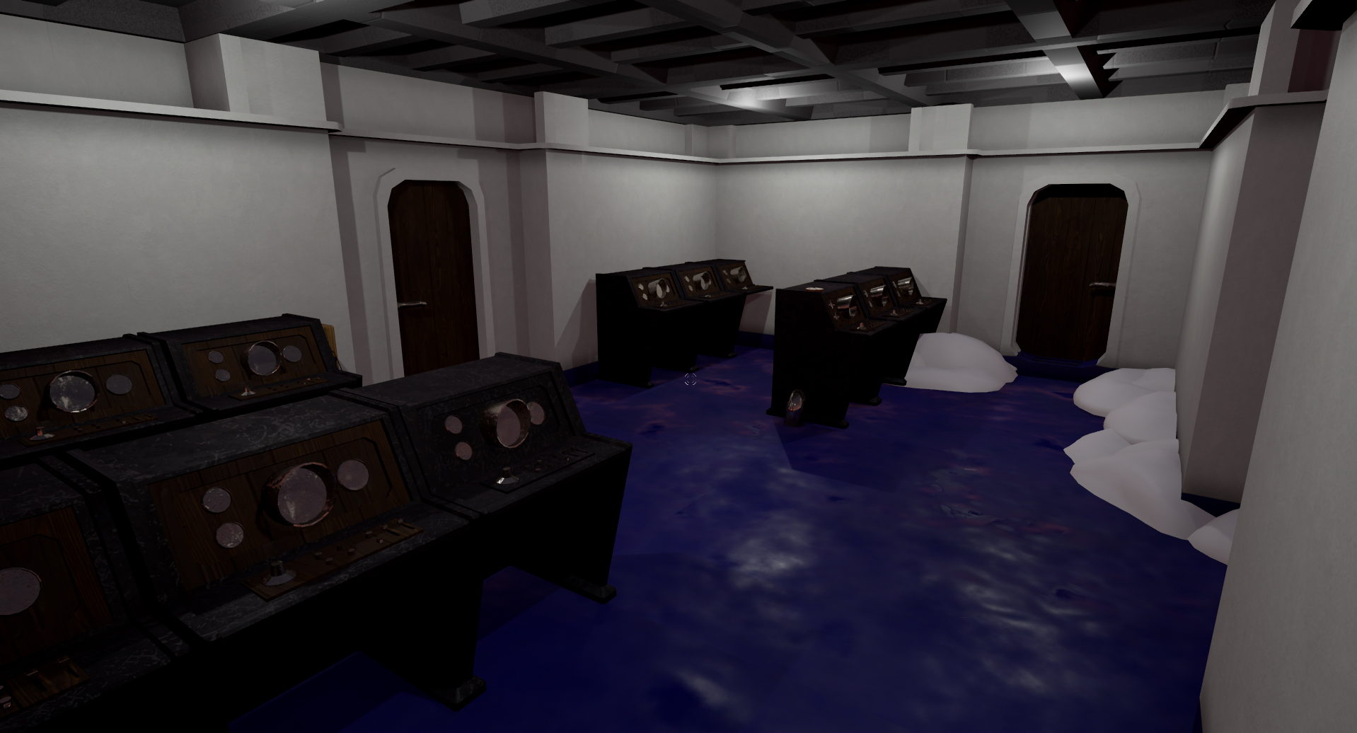

Slide 12
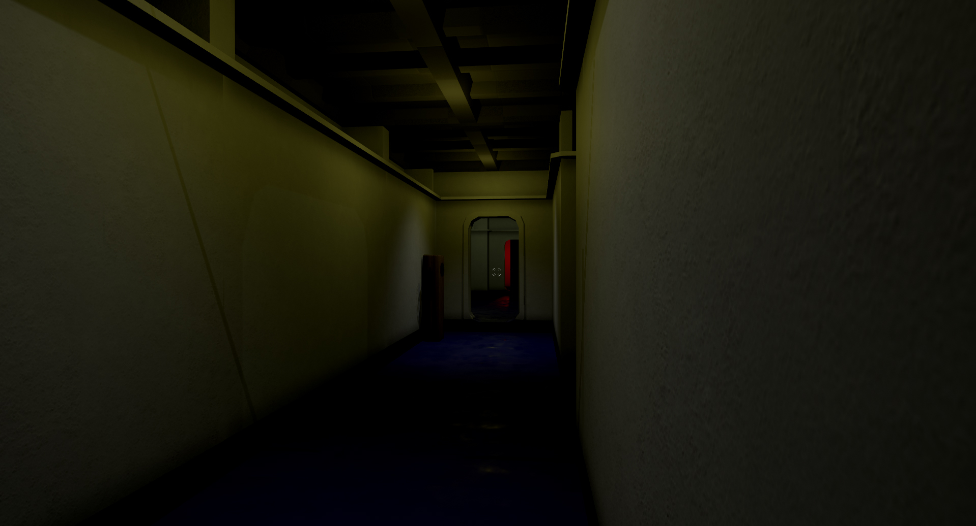

Slide 13
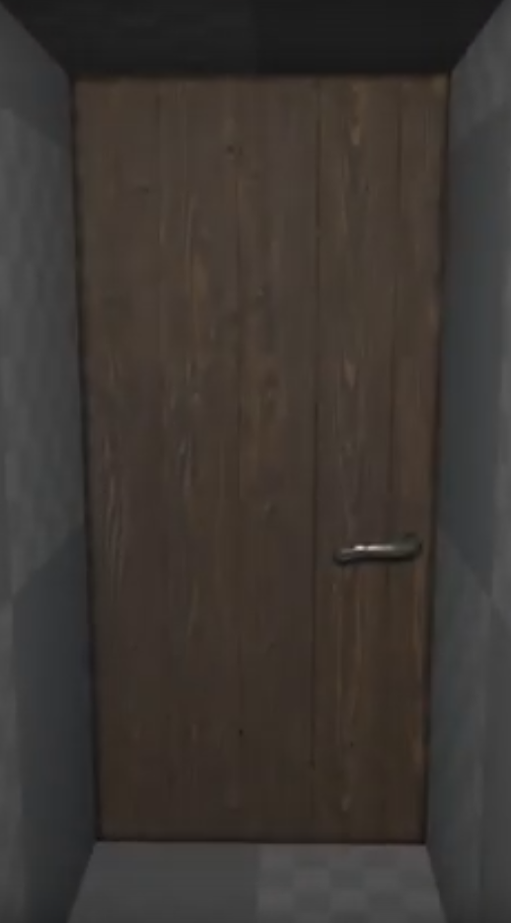
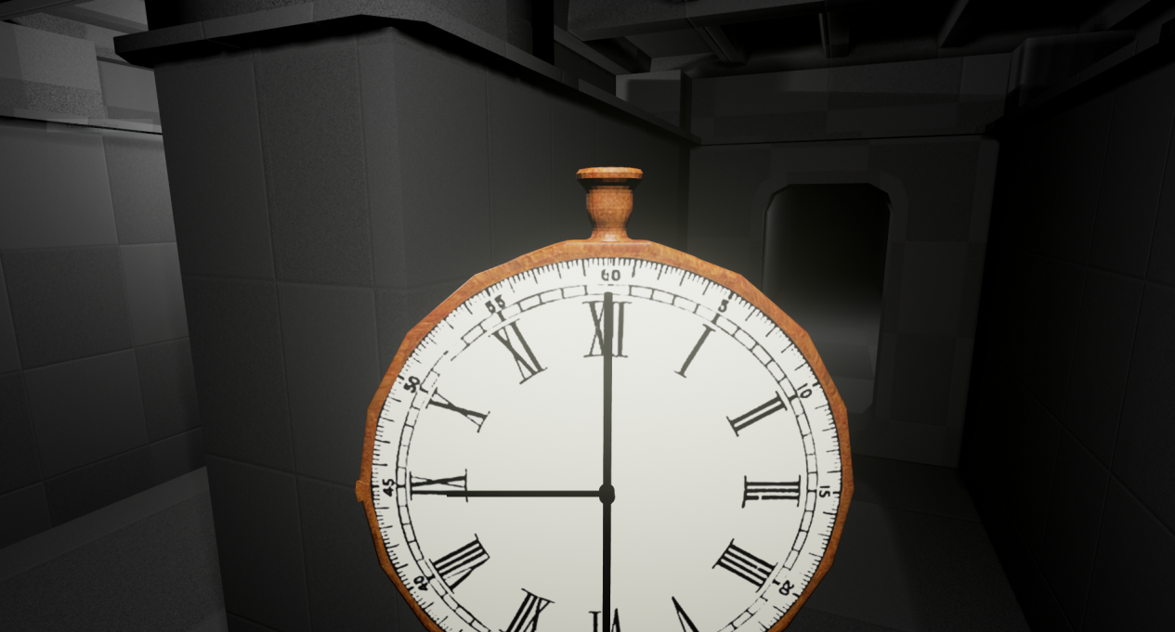
Art Assets
Rescaling modular tiles.
Clutter items.

Slide 14
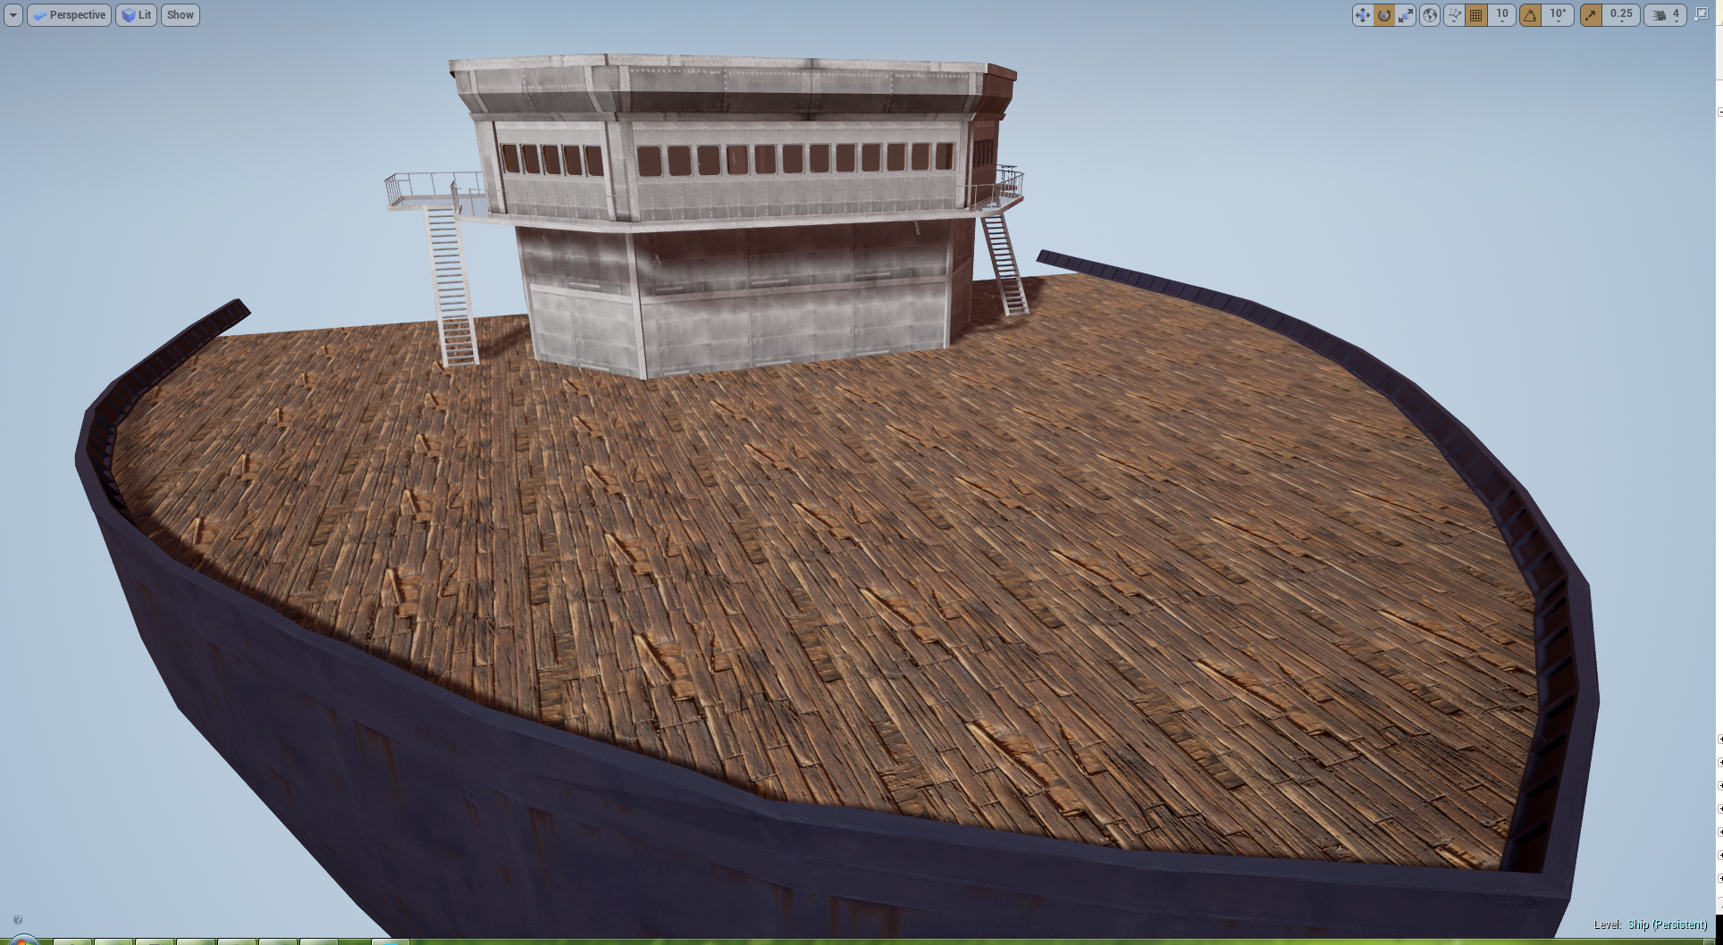

Slide 15
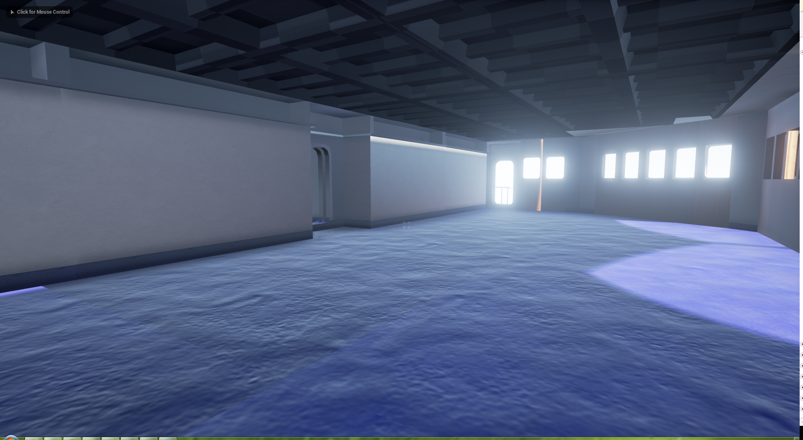

Slide 16
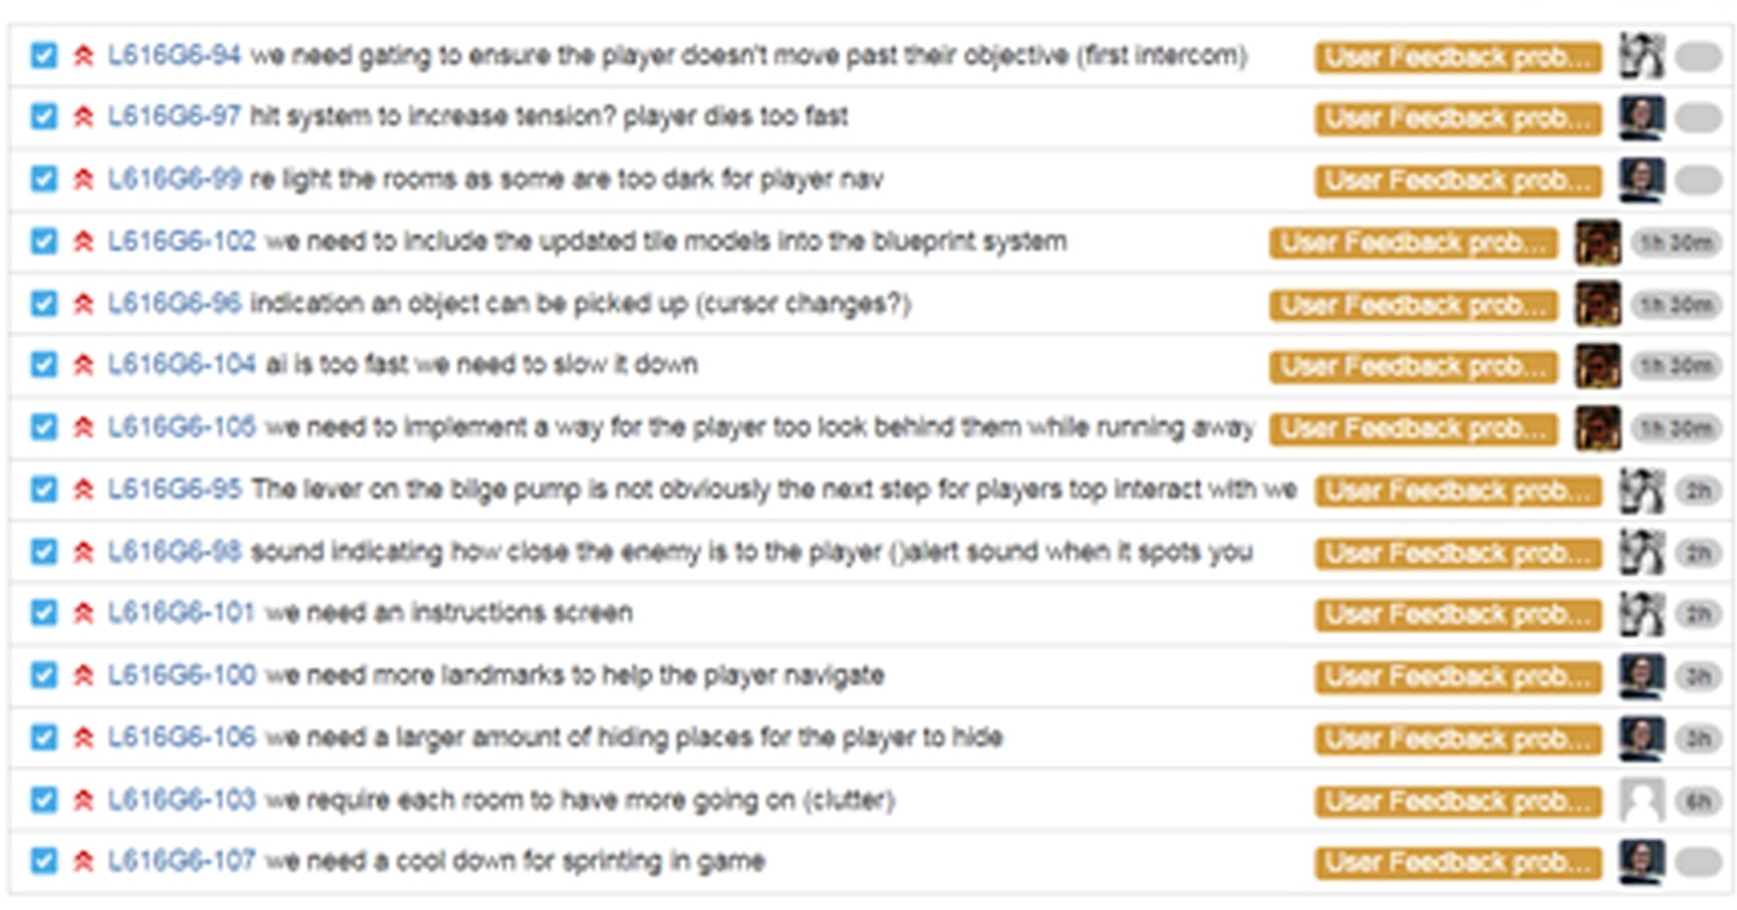
User Feedback & Solutions
https://youtu.be/e_e36ghaZYI
https://youtu.be/unam9Jt3LUs
https://youtu.be/9FwuU6HT82s
https://youtu.be/BO1PxjRBFQk
https://youtu.be/FPz1fvgDx8U
https://youtu.be/WZkHL-Qf5Ow
https://youtu.be/Ps6w7HE90SI
https://youtu.be/takHFWPpVW0
https://youtu.be/GztqwFqUo3c https://youtu.be/ln6A5y-BVLo
https://youtu.be/cwaFKp-vbWM
https://youtu.be/jtMutZwkwgw
https://youtu.be/ZQB6888cPDk
https://youtu.be/1WD5-Ks_Y4M

Slide 17
Management:
Communication has been good after robs meeting with us on Wednesday last week.
The team are lagging on jira tasks

Slide 18
Thank you for listening , Any Questions?
References
Bartle, R. (1996) Richard A. Bartle: Players Who Suit MUDs, Mud.co.uk. Available at: http://mud.co.uk/richard/hcds.htm (Accessed: 17 October 2016).
Phillips, M. and Huntley, C. (2004) Dramatica. Glendale, Calif.: Write Brothers Press.
Schell, J. (2008) The art of game design. Amsterdam: Elsevier/Morgan Kaufmann.

